Slide 1
FinPersonaAI
Your Personal Financial Advisor

Slide 2
MEET OUR TEAM - AImonarchs
-> BHAVINI SINGH
-> SAMRIDDHI AGARWAL
-> VANSHITA RAMESH SINGH
-> VISWONATHAN MANORANJAN

Slide 3
— Forbes
“Personalization is not a trend — it’s a customer expectation."

Slide 4
01
Problem and Solution

Slide 5
Modern banking faces challenges such as generic financial advice that fails to meet individual customer needs. Additionally, 78% of banking customers express a desire for personalized financial assistance, yet only 28% receive tailored recommendations, leading to missed optimization opportunities.
PROBLEM STATEMENT:

Slide 6
OUR SOLUTION - FinPersona AI
A comprehensive platform that leverages artificial intelligence to deliver hyper-personalized financial insights and product recommendations
Core Value Proposition:
Bridges the gap between generic banking services and unique customer needs
Enables better financial decision-making
Helps financial institutions offer more relevant products and services
Creates a 24/7 personal financial advisor experience

Slide 7
PROJECT OVERVIEW
FinPersona AI is an advanced AI-driven platform designed to provide personalized financial insights and product recommendations. By analyzing multi-dimensional customer data, it empowers users to make informed financial decisions while helping banks tailor their offerings to individual needs.

Slide 8
02
Key Features & Use Cases

Slide 9

Intelligent Dashboard
AI-generated insights about spending patterns
Interactive expense breakdowns
6-month trend analysis
Spotlight recommendations
Benefits:
  Immediate financial snapshot
  Proactive financial guidance
  Simplified complex financial data
Hyper-Personalized Product Recommender
Percentage match scores for each recommendation
Contextual reasoning in natural language
Highlighting of most relevant features
Interactive feedback mechanisms
Benefits:
  Higher product adoption rates.
  Improved customer satisfaction .
  Better financial outcomes

Slide 10
Transaction Intelligence
Sentiment analysis of financial behavior
Anomaly detection in spending
Categorized transaction timeline
Predictive insights on upcoming expenses
Optimization opportunities
Benefits:
  Proactive financial management
  Early detection of financial issues
  Data-driven financial planning
AI Financial Assistant
Understands financial questions and context
Maintains awareness across conversations
Provides personalized advice
Offers goal-oriented guidance
Benefits:
  24/7 financial guidance
  Personalized financial education
  Builds financial confidence

Slide 11
03
SYSTEM ARCHITECTURE

Slide 12
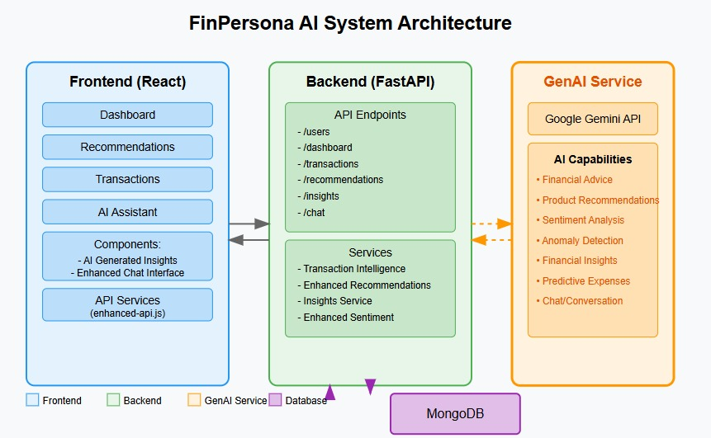

Slide 13
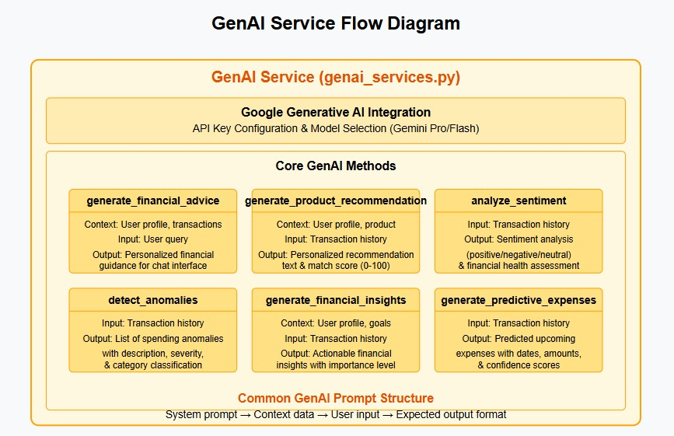

Slide 14
04
TECH STACK & SNAPSHOTS

Slide 15
FRONT-END
→ React.js, Material UI, Recharts
BACKEND
→ FastAPI, Python
DATABASE
→ MongoDB
AI/ML
→ Custom sentiment analysis, recommendation engine, LLM Model [Gemini]

Slide 16
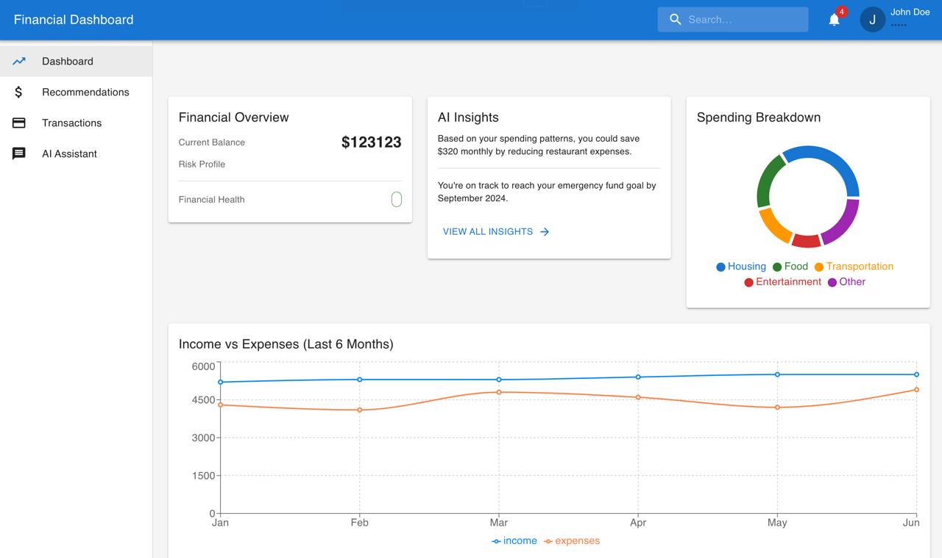

Slide 17
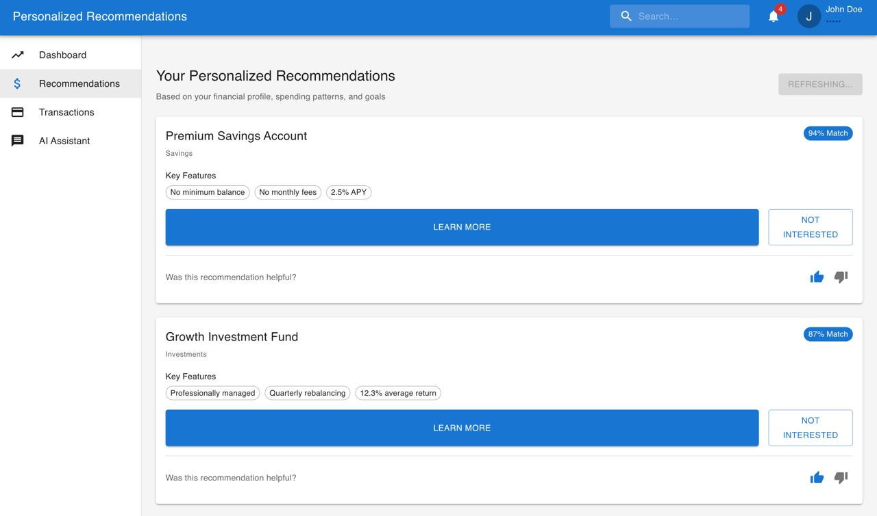

Slide 18
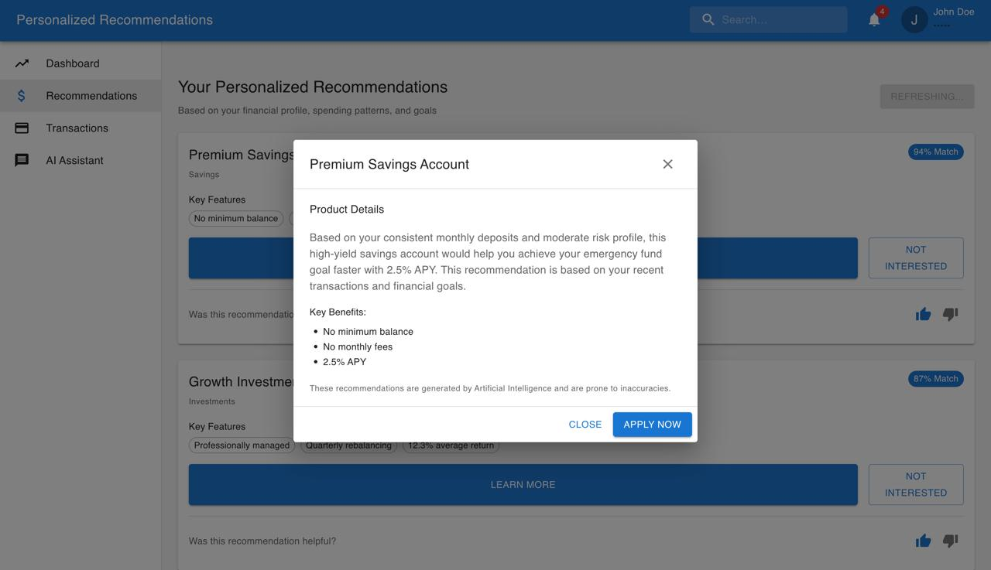

Slide 19
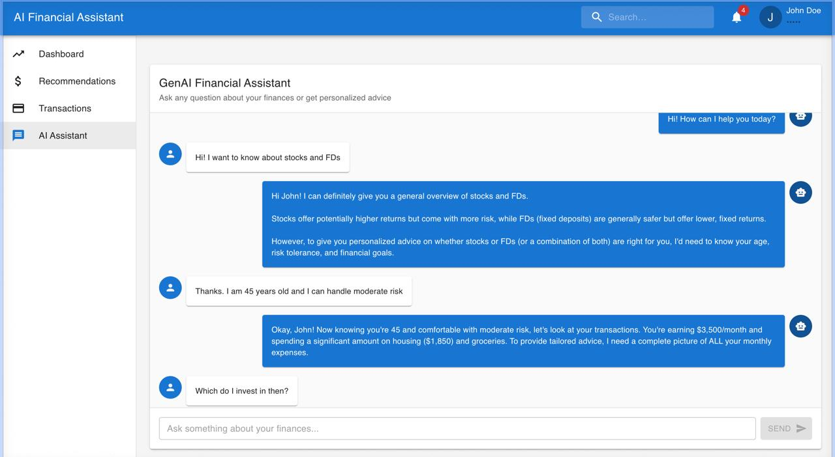

Slide 20
Thank you!

